Slide 1
Updates in contraception 2021
Sarah Prager, MD, MAS
University of Washington
SPHMMC

Slide 2
Disclosures
Some contraceptives mentioned may not yet be available in Ethiopia

Slide 3
Objectives
Present the new hormonal contraceptives being introduced in Ethiopia
Discuss drospirenone containing contraceptives and how they compare with other birth control pills
Introduce several other new hormonal contraceptives available or under investigation around the world

Slide 4
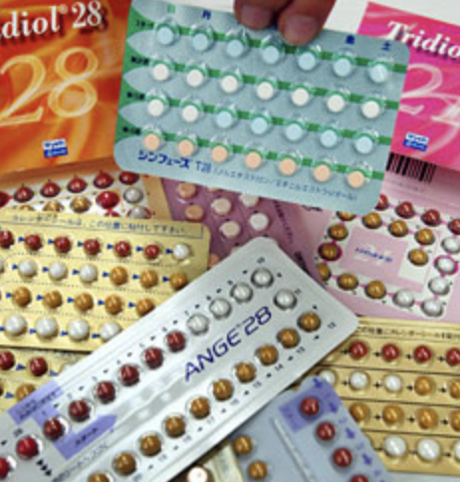
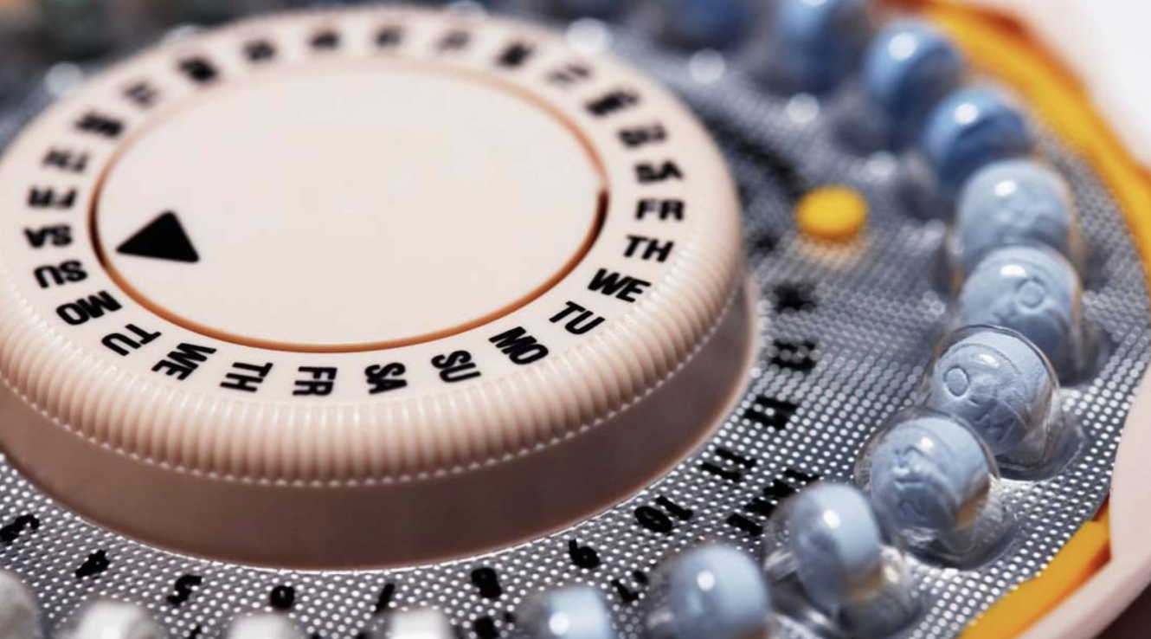
Hormonal Contraception

Slide 5
Progestin
Generations
Metabolites
Estranes: Norethindrone, norethindrone acetate, ethynodiol diacetate
Gonanes: Levonorgestrel, norgestrel, norgestimate, desogestrel
Drospirenone
1st: Norethindrone
2nd: Levonorgestrel, norgestrel
3rd: Desogestrel, norgestimate
4th: Drospirenone
Notes:
This is where things get a little more complicated b/c we have more options.
You may be used to thinking of progestins as categorized into generations. With first generation being norethindrone, second levonorgestrel and norgestrel, third is desogestrel and norgestimate, and 4th drospirenone.
And while this is a common way to classify progestin, it does us a disservice because there is really not a scientific foundation for these designations; they were actually derived as a marketing technique. Prior to 1992 there were no generation classifications, but when new pills came on the market with a different progestin, they were marketed as a different generation and were considered a safer option, offering less VTE risk, which isn’t necessarily true.
Instead of thinking about progestins in generations, a more functional way to think about them is grouped by metabolites.
All estranes are converted to norethindrone. All gonanes are not converted to the same compound but can be thought of as close cousins. The parent hormone to both is testosterone.
Back to organic chemistry - The main difference between estranes and gonanes has to do with having a methyl group or an ethyl substitution at 13-carbon position so they are quite similar compounds. What that means clinically, is that the gonanes tend to have more progestational and less androgenic receptor activity, but that does not necessarily equate to androgenic side effects.
The third metabolite is drospirenone – it is it’s own group. The parent hormone to drospirenone is spirolactone. Steroids in this class contain varying degrees of antimineralocorticoid, anti-androgenic, and progestogenic activity. The most widely known medicine in this class is spironolactone (a potassium sparing diuretic with antiandrogenic properties). Drospirenone is an analogue of spironolactone that has more progestogenic activity and less antimineralocorticoid affinity.

Slide 6
Estrogen
Estradiol (E2)
1º estrogen of reproductive years
Mestranol
Original formulation: 150 mcg
Ethinyl estradiol (EE)
Used in most combined hormonal contraception
Dose: 10 – 50 mcg
Estradiol Valerate (E2V)
Mechanism
Suppresses FSH -> prevents dominant follicle
Notes:
The estrogen secreted by the ovaries from menarche to menopause is Estradiol. It is the most potent of the natural estrogens, and it is regulated by the hypothalamic-pituitary ovarian axis. When given orally, estradiol undergoes first pass metabolism by liver and has half life of 14-16 hours
Mestranol was the original synthetic estrogen, is a prodrug of EE, and was used at dose of 150 mcg initially (equivalent to approximately 105 mcg EE). now it is used at 50 mcg doses (35-40 mcg EE equivalent) though is rarely used.
EE is the primary estrogen compound in combined oral contraception and is available in doses from 10 – 50 mcg. It undergoes first pass metabolism by the liver and (unlike estradiol) it remains highly potent in its conjugated form
Estradiol valerate - metabolizes to estradiol, only one pill with estradiol valerate available so far in the US, no clear benefits over EE
The estrogen component of combined oral contraceptives works by suppressing FSH. FSH has the role of recruiting the dominant follicle so when it is suppressed no dominant follicle emerges.

Slide 7
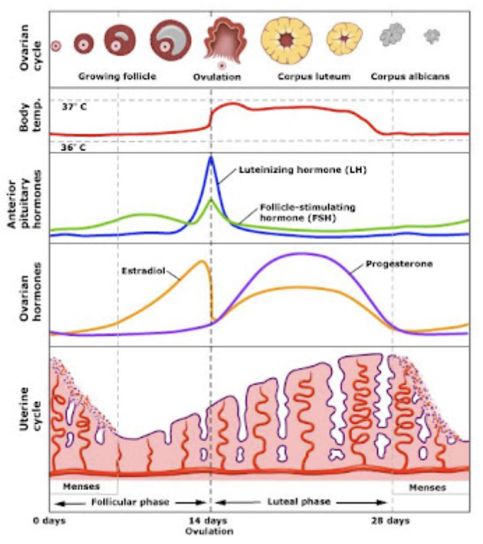
A word on pharmacodynamics
Notes:
The primary mechanism of action of oral contraceptive pills is to suppress the hypothalamic pituitary ovarian access.
Estrogen component contributes to suppressing FSH thus attenuating follicle development
Progestin suppresses LH release. No LH surge, no ovulation. The progestin component also serves to thicken cervical mucus and changes the endometrium to have predominantly exhausted and atrophied glands.
EE also potentiates progestins action. What I mean by this is that estrogen increases the concentration of progestin receptors. So a small amount of estrogen enhances the efficacy which has allowed for smaller amounts of progestin. The estrogen also balances the progestin effect on the endometrium which helps to reduce breakthrough bleeding.
The metabolism of EE varies significantly from individual to individual and from one population to another. There can even be a range of variability at different sampling times within the same individual. So, it is not surprising that the same dose can cause side effects in one individual and not in another. Sometimes this can be frustrating for our patients, and it takes reassurance and some trial and error to find the best combination pill
Progestin dominant endometrium: (decidualized bed with exhausted and atrophied glands)

Slide 8
Monophasic vs multiphasic
Monophasic
Traditional formulation
Every active pill has same dose
Multiphasic
Biphasic
Triphasic
Multiphasic
Endless options!
Take home point: it does not matter
Notes:
Pills come in mono and multiphasic formulations.
In monophasic formulations, Every active pill has same amount of estrogen and progestin. This is the original and traditional formulation and is still most common.
Phased pills emerged in the late 1970s. There are biphasic, triphasic, and multiphasic regimens. Some alter the progestin dose, others varied both the estrogen and progestin doses throughout a single cycle.
The phasic regimens were created to lessen the total dosage and minimize potential metabolic changes and side effects. Some products were created simply to provide patent protection for a company.
Overall, metabolic studies of multiphasic preparations indicate no differences or very slight improvements over the metabolic effects of monophasic products. There is no difference in efficacy. When it comes to breakthrough bleeding, they are essentially the same.
The take home point here, is that when starting a pill, it is very reasonable to start someone on a monophasic formulation.

Slide 9
Regimens
Cyclic
Extended
21/7
24/4
Tricycle
Continuous
Flexible
Notes:
With the initial pills in the 1960s, an era where there were no urine pregnancy tests or ultrasounds, the monthly withdrawal bleed was built in to assure people they were not pregnant. And with the hormone doses being so high, it took 4-5 days for a woman to metabolize the hormone and reduce her serum levels low enough to initiate endometrial shedding. Thus the 21/7 cyclic pill was born.
With a 21/7 cyclic pill in today’s era where the doses of hormone are lower, the hypothalamic-pituitary ovarian axis returns to near normal activity quickly after the last dose. This means that by day 7, the axis is activated and a follicle begins to undergo recruitment. With the hormone-free week allowing a dominant follicle to develop any delay in beginning the subsequent cycle may increase the risk of ovulation and pregnancy. This delay is the concept of escape follicular activity
Shortening the pill-free week – said another way – increasing the number of active hormone days overcomes the risk of escape ovulation, because it suppresses gonadotropins for longer. and this holds true regardless of EE dose. The 24/4 regimen also has the added benefit of fewer days of withdrawal bleeding, which can be a positive side effect for many patients.
One of the major obstacles with taking OCPs is needing to go to the pharmacy every month which often causes a delay in starting the next pack. And if using a 21/7 regimen, a delay in picking up and starting the next pack allows for an even longer hormone-free time which increases the likelihood of ovulation and unintended pregnancy. Having a shorter hormone-free week gives a little bit of wiggle room to maintain efficacy should there be a delayed start in the next pack.
Take home point – when deciding between a 21/7 and 24/4 regimen, I recommend a 24/4 regimen for it’s better cycle control and decreased potential for escape follicular activity.
Moving away from cyclic regimens to extended regimens….
The tricycle extended regimen is a convenient approach b/c it reduces the number of withdrawal bleeds to 4 per year. This is 84 active pills followed by 7 placebo pills – you may know it as Seasonale – which is a 30 mcg EE and 150 mcg LNG for 84 days followed by 7 hormone free days. Seasonique is quite similar - it just swaps out placebo pills for 7 pills with 10 mcg of EE
There is the option to take active pills continuously without any breaks. Lybrel is a year-long formulation with 20 mcg EE and 90 mcg LNG daily for 365 days. But any low-dose monophasic pill is suitable for continuous dosing. A potential disadvantage is breakthrough bleeding, particularly early on, but this usually improves over time.
Flexible or tailored regimens refers to an extended cycle of variable length. Typically, the decision to end the active pills is prompted by an episode of breakthrough bleeding. So when the BTB occurs, the person should initiate One 4-day hormone-free interval followed by returning to active pills. A hormone-free interval can only be taken if active pills have been taken for at least 21 days prior. The rational for the flexible cycle is that this 4-day break from pills improved bleeding patterns in women previously using continuous pills without compromising contraceptive efficacy.
Take home point for extended regimens: it really depends on the patient. Overall, the ovarian activity is better suppressed with extended regimens, and it is really up to the patient on when or if they would like a withdrawal bleed.

Slide 10
Choosing which pill
TAKE HOME POINTS:
Most patients do well with any pill
Focus on individual patient preferences
All combination pills are similar
Notes:
There are numerous different types of pills and even more brand names and it is important to remember that most patients do well with any pill.
Focusing on a woman’s preferences is an excellent basis for choosing an initial pill
She might consider her own past experiences, the good or bad experiences of her friends or family, preferences based on marketing message
All pills are very, very similar. So while some pills have “approval” for dysmenorrhea or acne treatment, pills without those labels are likely to provide the same benefits. It’s just quite costly to carry out a clinical trial to demonstrate the benefits.
Once you are comfortable that a patient is medically eligible for the pill, and if she doesn’t have a preference for one over another, a good place to start is a pill with a 24/4 formulation containing 20 mcg EE such as Loestrin 24 Fe or Yaz. If together you decided on fewer withdrawal bleeds per year, an extended regimen 84/7 pill containing 30 mcg EE such as seasonale is a good place to start

Slide 11
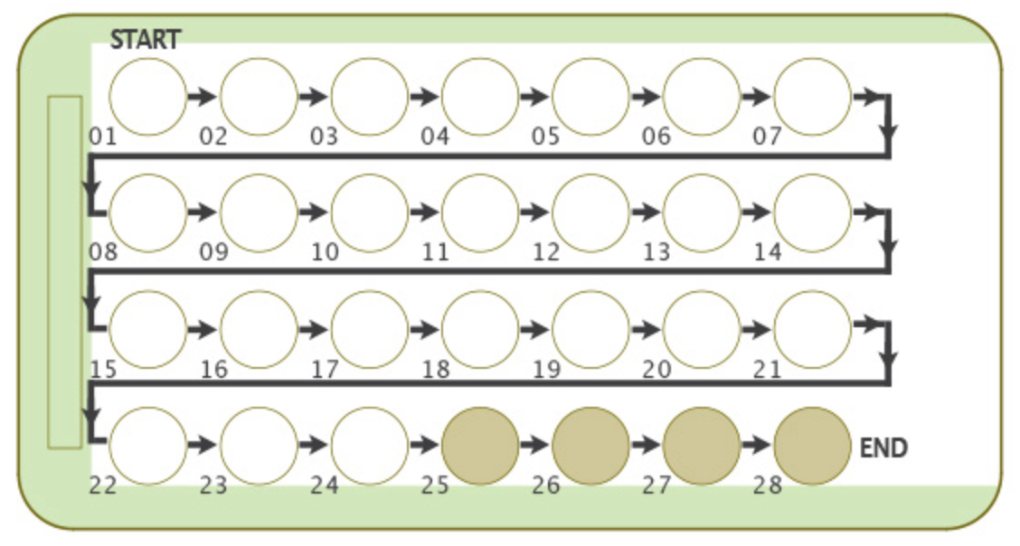
New Oral Contraceptives
Drospirenone +/- Ethinyl Estradiol
Drospirenone (DRSP):
Antimineralocorticoid
decreased bloating/water weight gain
Antiandrogenic
decreased acne/hirsutism
Improved libido?

Slide 12
Drospirenone 3 mg + Ethinyl Estradiol 0.02 mg
24 active pills and 4 placebo pills
Approved for contraception
U.S. – also approved for treatment of mild-moderate acne in women/girls ≥ 14 years
Increased venous thromboembolism risk?
Dispelled in several-conducted, prospective cohort studies
INAS study – HR DRSP 24 vs. LNG COC: 0.8 (0.4-1.5)
Dinger JC et al. Contraception 2014 Apr, 89:253-63; Dinger JC et al. Contraception 2007 Feb;75):344–354

Slide 13
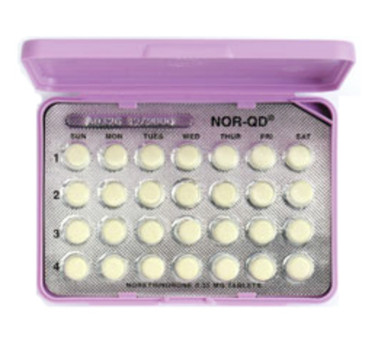
“Traditional” Progestin-only pill
Norethindrone 350 mcg daily
Same time!
No hormone-free days
Mechanism
Thickening cervical mucus
Does NOT reliably inhibit ovulation
Vulnerable efficacy
More breakthrough bleeding
Notes:
The traditional progestin-only pill is known as the mini-pill. It contains 350 mcg of norethindrone that must be taken at the same time daily. This method is very sensitive to timing. If a pill is taken more than 3 hr late, a backup method for 48 hr
There are no hormone-free days
For progestin-only pills, ovulation is only suppressed in about 50% percent of cycles so it primarily works by thickening of cervical mucus, which inhibits sperm penetration.
Progestin-only contraception is associated with more unscheduled (breakthrough) bleeding.
For many years, this has been the only option on the market

Slide 14
Drospirenone 4 mg
24 active pills and 4 placebo pills
Mechanism of action: suppression of ovulation
Low failure rate
1.8% (Pearl index = 4)
Efficacy persists even with BMI > 30
Half life 24-30 hours
Less strict on timing of daily pill
Reduced breakthrough bleeding
Reduced dysmenorrhea over time

Slide 15
New 1-Year Contraceptive Ring (Vaginal System)
Segesterone acetate and ethinyl estradiol vaginal system (brand name: Annovera®)
FDA approved as of August 10, 2018
Commercially available at end of 2019 in the US
Same contraindications, side effects, mechanism of action as other combined hormonal contraceptives
Also does not protect against STIs
Notes:
-Developed by the Population Council, a global non-profit research organization
-2 ¼ inches in diameter, flexible and non-biodegradable ring, made of silicon (no latex)
-The vaginal system is a combined hormonal contraceptive, so has the
Same restrictions: women over 35 who smoke; high risk of VTE; etc. (full list on prior slide)
Same side effects: headache/migraine, nausea/vomiting, yeast infections, abdominal pain, dysmenorrhea (painful menstruation), breast tenderness, irregular bleeding, diarrhea and genital itching.
Same mechanism of action: preventing ovulation

Slide 16
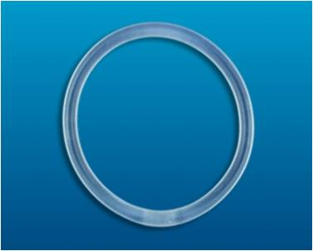
Similarities and differences between contraceptive rings
 | New 1-Year Contraceptive Ring (Annovera®) | Existing Monthly Contraceptive Ring (NuvaRing®)
Estrogen component | Ethinyl estradiol: 0.013mg/day released | Ethinyl estradiol: 0.015mg/day released
Progestin component | Segesterone acetate (Nestorone®): 0.15mg/day released | Etonogestrel: 0.12 mg/day released
Each ring | Reinsert/reused for 1 full year (i.e. fewer trips to the pharmacy) | Only good for 1 month (i.e. place a new ring each month)
Storage | Refrigeration never needed (can withstand storage temperatures up to 86°F) | Refrigeration recommended prior to dispensing to patients Room temperature (68°F to 77°F) sufficient for 4 months
BMI | Not adequately studied in patients with BMI > 29 kg/m² | Proven to be effective in obese patients
Notes:
The amount of ethinyl estradiol (EE) released by both the 1-year contraceptive vaginal ring and the existing monthly vaginal ring is comparable, and is considered a low dose of estrogen. In comparison, the amount of EE in an oral combined hormonal contraceptive is between 0.02mg – 0.035mg/day.
Segesterone acetate is a new synthetic progestin.
This is a potent 19-nor-testosterone derivative that is not orally active but is effective as an implant, transdermal patch, and via absorption through the vaginal mucosa
Segesterone acetate does not bind to androgen or estrogen receptors, so may avoid side effects related to androgenic progestins (such as acne)
In comparison, the existing contraceptive vaginal ring contains the synthetic progestin etonogestrel, which is the same progestin used in the implant. Etonogestrel is considered a “third generation” progestin.
Because the new contraceptive ring may require fewer trips to the pharmacy and it is less likely a patient may run out of rings, it is thought that it will have a higher effectiveness than the monthly ring (quoted as 97.3% effective in the clinical trials leading to FDA approval). In contrast, typical use of the NuvaRing is quoted as 91%.

Slide 17
Similarities and differences between contraceptive rings
 | New 1-Year Contraceptive Ring (Annovera®) | Existing Monthly Contraceptive Ring (NuvaRing®)
Benefits | Patient-controlled Patient doesn’t have to think about it/remember to do something everyday Doesn’t need to be removed during sex…
Drawbacks | But if it is removed, must be replaced within a short period of time (otherwise contraceptive efficacy is reduced and back-up contraception is needed for 7 days)
 | Must replace within 2 hours | Must replace within 3 hours
Continuous use (avoiding menses) | Not yet studied or recommended | Considered OK to use for up to 35 days; considered OK to use continuously

Slide 18
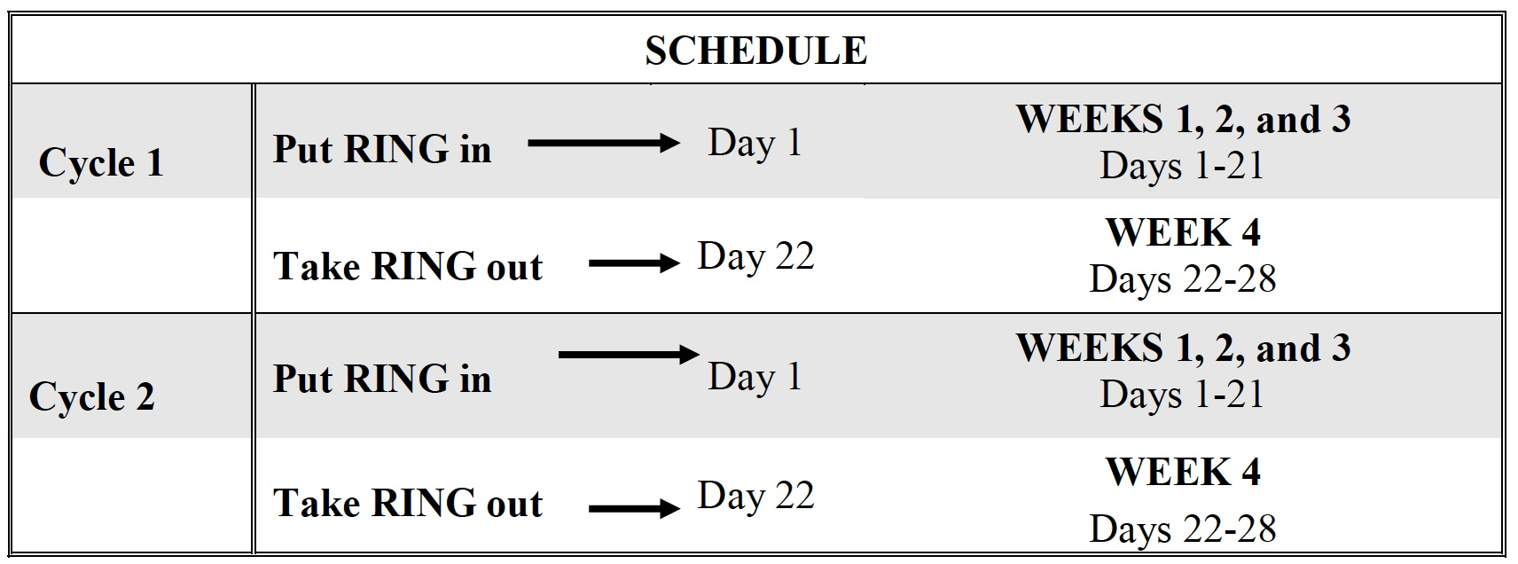
Schedule for use of the new contraceptive ring
Notes:
What instructions do we give to patients?
Place the ring in the vagina for three weeks (21 days)
Then, keep the ring out of the vagina for 1 week (7 days); this is when you will experience bleeding.
Put the ring in and take it out on the same day of the week at about the same time (such as Monday morning at 8am).
This schedule is repeated every four weeks for one year (thirteen 28-day menstrual cycles). Then, you will need a new ring.
In a 28-day cycle, a deviation that involves the device being out of the vagina for more than 7 days will increase pregnancy risk and back-up contraception is recommended in these instances.

Slide 19
More instructions for use of the new contraceptive ring
During the 7 days not in use:
Wash and store in compact case
Only use water-based creams or lubricants in the vagina
Anticipatory guidance:
71% of all subjects in an acceptability study of the new contraceptive ring reported that they never felt the ring during intercourse
Merkatz RB et al. Acceptability of the nestorone®/ethinyl estradiol contraceptive vaginal ring. Contraception (2014); 90(4):514-421.
Notes:
69% of women in the clinical trials reported that they never felt Annovera during intercourse
84% of women reported no change or an increase in sexual activity
86% of women reported no change or an increase in sexual pleasure with Annovera
78%, reported that Annovera never affected their partner’s sexual pleasure
Reference
Merkatz RB et al. Acceptability of the nestorone®/ethinyl estradiol contraceptive vaginal ring: development of a model; implications for introduction. Contraception (2014); 90(4):514-421.

Slide 20
Emergency Contraception
Method | Dose | Timing | Failure Rate
Levonorgestrel | 1.5 mg | < 120 h | 2.6%
Ullipristal acetate | 30 mg | < 120 h | 1.4%
Mifepristone | 10 mg | < 120 h | 1.5%
Copper IUD* | 1 IUD | < 120 h | 0.1%
LNG-IUD | 1 IUD | < 120 h | 0.3%
Cleland K et al. The efficacy of intrauterine devices for emergency contraception: a systematic review of 35 years of experience. Hum Reprod 2012;27:1994-2000.
Glasier AF et al. Ulipristal acetate versus levonorgestrel for emergency contraception: a randomised non-inferiority trial and meta-analysis. Lancet 2010;375:555-62
von Hertzen H et al. Low dose mifepristone and two regimens of levonorgestrel for emergency contraception: a WHO multicentre randomised trial. Lancet 2002;360:1803-10
Turok D et al. Unpublished data until 1/28/21
Notes:
You have another patient. She isn’t using contraception, had her LMP 10 days ago, and wants EC from you. What are your choices? -click-
She could get a copper IUD, plan B (levonorgestrel), or Ella (ullipristal acetate). You could also do a combined estrogen-progestin regimen, but as that has lower effectiveness than these methods, I’m focusing on these three.
For plan B, 1.5 mg of levonorgestrel, she can get this over the counter. It’s FDA-approved to 72 hours but has effectiveness to 120. It may be less effective in women weighing over 75 kg, but the benefits still outweigh the risks. (mechanism: delays ovulation. May have endometrial effects affecting implantation.)
Ullipristal is a selective progesterone receptor modulator. It requires a prescription but is more effective than levonorgestrel. It works by delaying ovulation.
The copper IUD is the most effective, but its use as EC is off-label in the US. This is tougher for patients to get than an OTC med or Rx, but has the advantage of being reliable contraception for 10-12 years should your patient desire. (mechanism: inflammation, inhibits sperm mobility/capacitation, post-fertilization effects)

Slide 21
IUD types
IUD | Total LNG dose | Amenorrhea @ 1 year | Device dimensions | Inserter diameter | Current FDA approval/evidence based use
Skyla® | 13.5 mg | 6% | 28 x 28 mm | 3.8 mm | 3 years/3 years
KyleenaTM | 19.5 mg | 12% | 28 x 28 mm | 3.8 mm | 5 years/5 years
Mirena® | 52 mg | 20% | 32 x 32 mm | 4.4 mm | 6 years/7 years
Liletta® | 52 mg | 20% | 32 x 32 mm | 4.8 mm | 6 years/7 years
Paragard® | n/a | n/a | 32 x 36 mm | 4 mm | 10 years/12+ years
LNG=levonorgestrel
Notes:
Levonorgestrel IUD comparison table
IUD Total LNG dose LNG release/ day Amenorrhea @ 1 yr* Amenorrhea @ 3 yrs* Device dimensions Inserter diameter Current FDA approval
Skyla 13.5mg 8 mcg/day 6% 12% 28 x 28 mm 3.8mm 3 years
Kyleena 19.5mg 9 mcg/day average (starts at 17.5mcg/day) 5% 18% 28 x 28 mm 3.8mm 5 years
Mirena 52mg 20 mcg/day (mean release rate 14mcg/day over 5 years) 20% 30-50% 32 x 32 mm 4.4mm (older inserter 4.8mm) 5 years
Liletta 52mg 18.6 mcg/day (20%) (30-50%) 32 x 32 mm 4.8 mm 3 years
* All amenorrhea rates from Bayer data w/ exception of Mirena 3 year data
ParaGard inserter tube = 4mm diameter

Slide 22
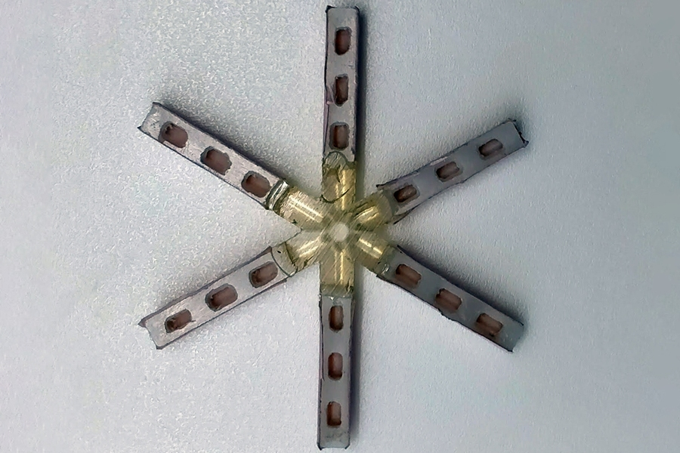
Under Development
Once-a-month pill:
Star-shaped device inside a dissolvable capsule
Slowly releases levonorgestrel into the stomach over the month
So far, studied only in pigs

